Slide 1

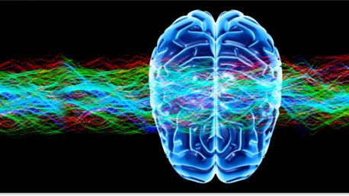


Neurophysiology - 2 Brain wave functions
Joshua Febus
Organizational Psychology
BioMetrics Inc

Slide 2
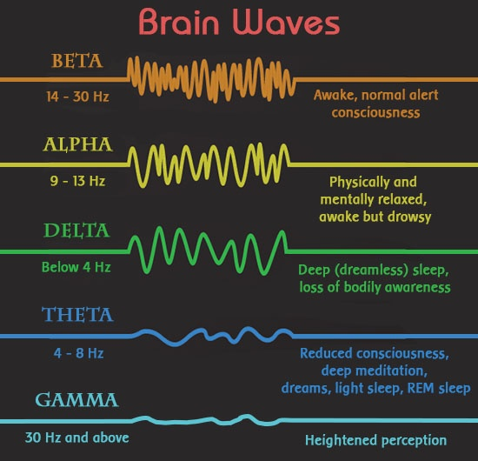
β receptor
θ
γ
α Signaling
δ
Notes:
Beta receptor integrates sensory information, Alpha receptors signal transmission of CSF. (cerebrospinal fluid) Delta waves are transmitted whenever REM sleep is activated, Theta waves occur in the 2nd part of the sleep cycle.
Gamma brainwaves are transmitted whenever you are engaged in a task.

Slide 3

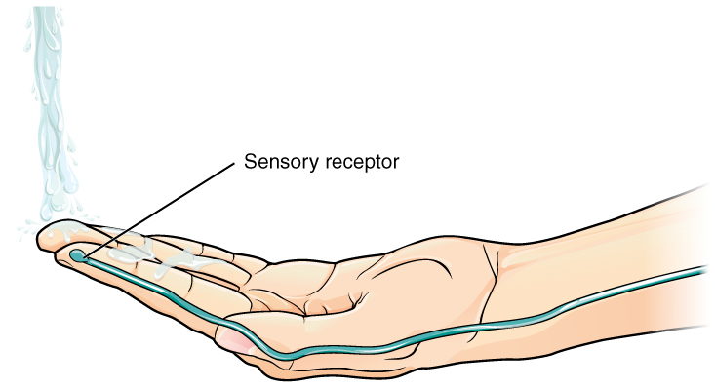
Currently you are perceiving vision of everything in site, you are rapidly integrating information.
Sensory Input
Integration
Motor Output
You may also be perceiving sound through music, or natural stimuli’s.

Slide 4
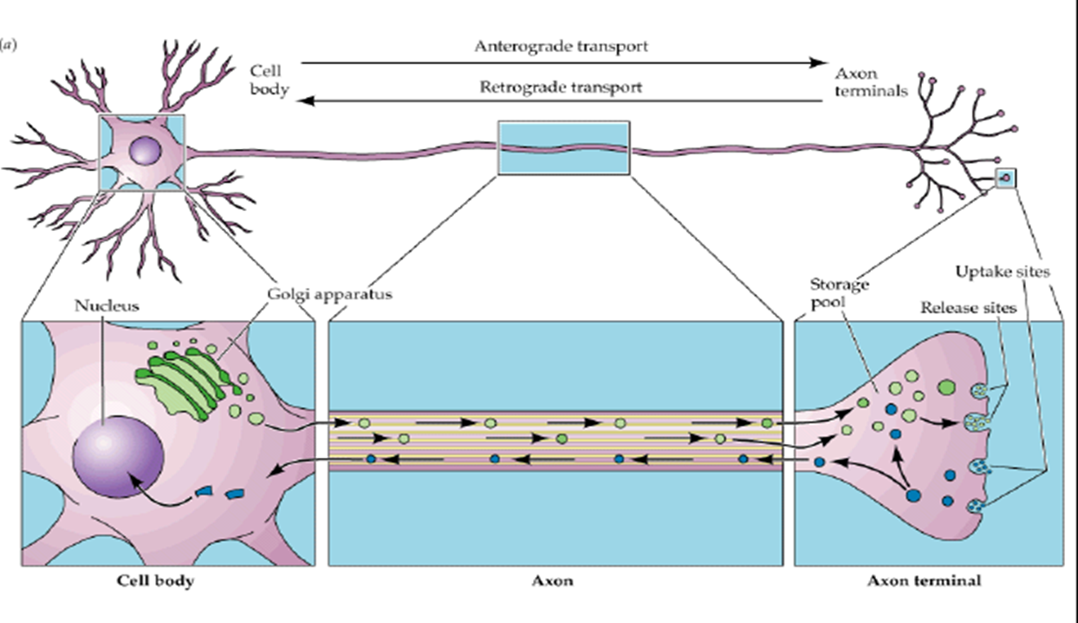

AXOPLASMIC TRANSPORT
Examples of these methods are the NA+K channels, Calcium channels, and electrical messaging through Ligand-Gated Ion voltage channels.
There are various methods of Axoplasmic transport

Slide 5
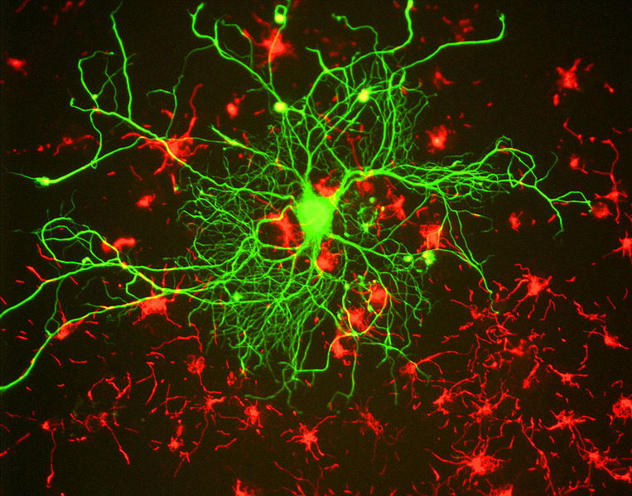
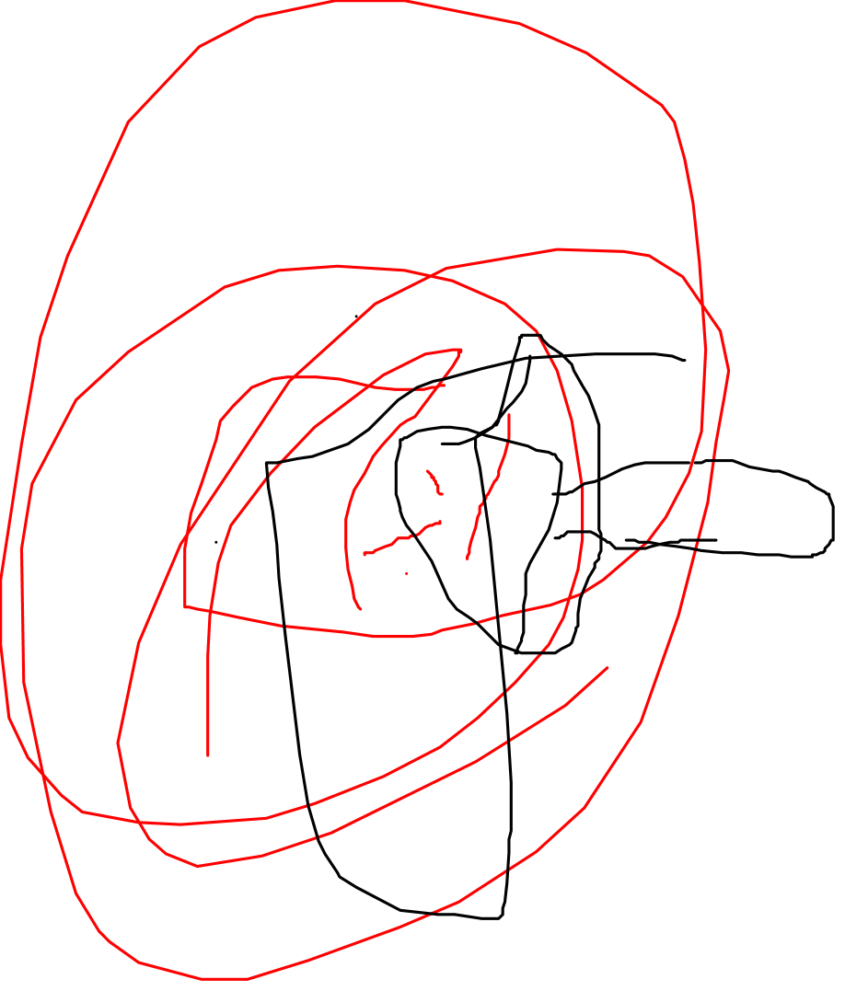
Communication in CNS Via Schwaan Cells
Schwaan cells stem from the CNS offering protection to pathogens, they act in accordance with the Neuroglia or simply called glia.
Glial cells act as the glue allowing electrical signaling to be sent throughout the body.
Schwaan cells work with Oligodendrocytes to keep the Central Nervous system healthy and maintaining optimal function.

Slide 6
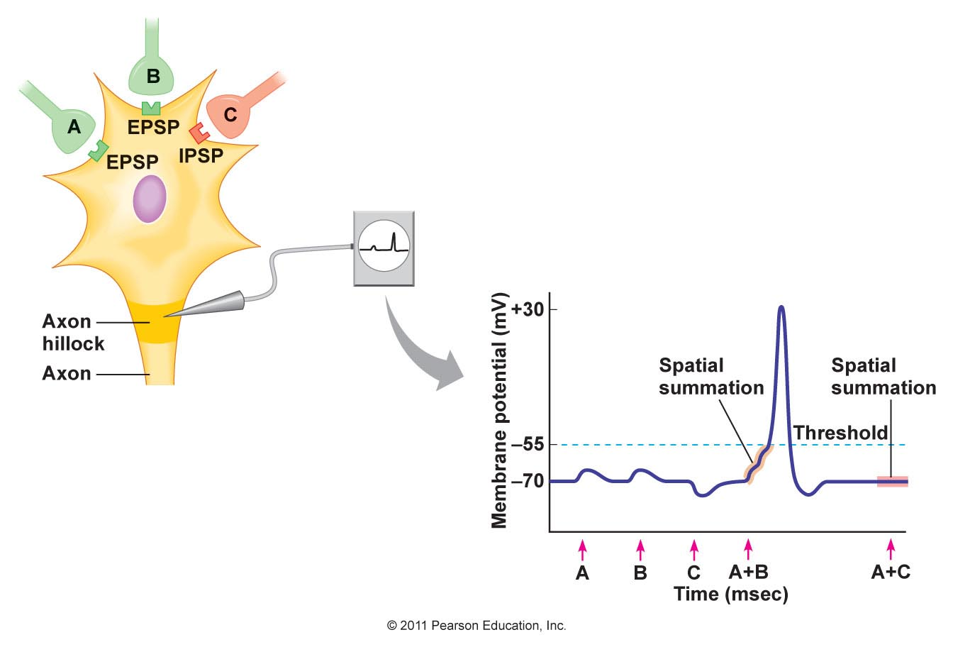
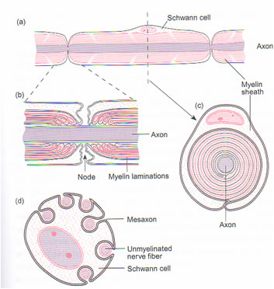
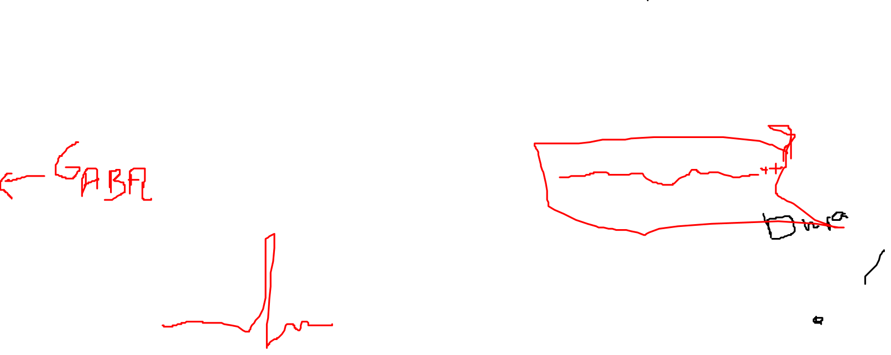
Spinal electrophysiology
Excitatory Post-Synaptic Potentials
Inhibitory Post-Synaptic Potentials
We went over Hyperpolarization
& Hypopolarization last video^

Slide 7
I’m always encorporating new things into the material hoping to give you an overview of everything I possibly think is going to show up on the MCAT related to Neurology, eventually I may branch out..
Considering making videos on different areas I’ve studied as well.

